Slide 1
Distributed Systems Clusters, Grids, Clouds, Future Internet
P434 Fall 2014
Lecture 4
Judy Qiu
http://salsahpc.indiana.edu
School of Informatics and Computing
Indiana University

Slide 2
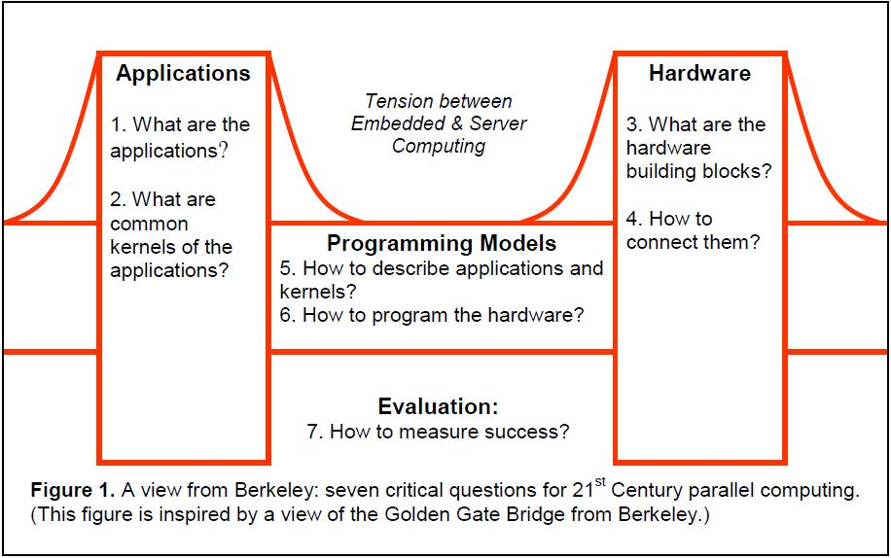
Seven Questions
The Landscape of Parallel Computing Research: A View from Berkeley

Slide 3
Parallel Applications and Dwarves
Traditional approach to evaluate architecture is through a benchmark suite based on existing programs
The best way to express a parallel computation is not clear
Higher level of abstraction is needed
Capture a pattern of computation and communication while avoiding details about the underlying architecture

Slide 4
13 Dwarfs
Dense Linear Algebra - Dense datasets
Sparse Linear Algebra - Data w/ many zeros
Spectral Methods - e.g. FFT
N-Body Methods - interactions between many discrete points, e.g. Barnes-Hut
Structured Grids - Regular grid; points are conceptually updated together, e.g. PDE solvers
Unstructured Grids - Irregular grid often with many levels of indirect memory access, e.g. vector computers with gather/scatter
MapReduce - Parallel computation on subsets of data, combined in an end-step
Combinational Logic - Simple operations on massive amounts of data (e.g. encryption)
Graph Traversal - Indirect lookups in search; little computation (e.g. Quicksort)
Dynamic Programming - Problem solving via solving simpler sub-problems
Backtrack and Branch-and-Bound - Global optimization for huge search spaces
Graphical Models - Bayesian Networks and Hidden Markov Models
Finite State Machines - Interconnected States as used in parsing; embarrassingly sequential
The Landscape of Parallel Computing Research : A View from Berkeley

Slide 5
Thinking Parallel

Slide 6
I have an application – can and should it be parallelized and if so, how should this be done and what are appropriate target hardware architectures; what is known about clever algorithms and what are recommended software technologies?
The Sourcebook of Parallel Computing

Slide 7

Parallel Computing Resources
1994
1996
2002
2006
2010
2012

Slide 8

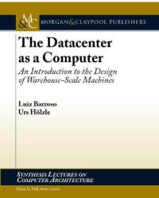
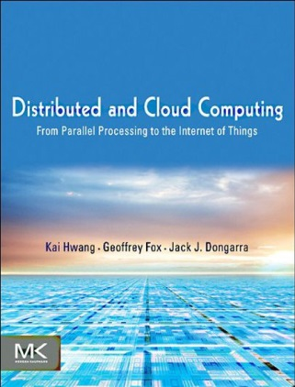
Big Data and Cloud Computing Books

Slide 9
Questions About Parallel Computing
Why powerful computers must be parallel processors
Large important problems require powerful computers
Why writing (fast) parallel programs is hard
Principles of parallel computing performance
all
Including your laptop
Even computer games
Applications of Parallel Computers, Kathy Yelick

Slide 10
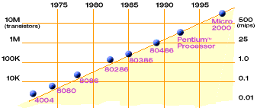
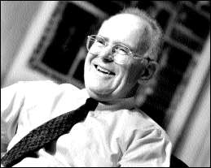
Technology Trends: Microprocessor Capacity
Moore’s Law
2X transistors/Chip Every 1.5 years,
Called “Moore’s Law”
Gordon Moore (co-founder of Intel) predicted in 1965 that the transistor density of semiconductor chips would double roughly every 18 months.
Microprocessors have become smaller, denser, and more powerful.
Jack Dongarra, ORLN

Slide 11
Flynn’s Instruction/Data Taxonomy of Computer Architecture
Single Instruction Single Data Stream (SISD)
A sequential computer which exploits no parallelism in either the instruction or data streams. Examples of SISD architecture are the traditional uniprocessor machines, like an old PC.
Single Instruction Multiple Data (SIMD)
A computer which exploits multiple data streams against a single instruction stream to perform operations which may be naturally parallelized. For example, GPU.
Multiple Instruction Single Data (MISD)
Multiple instructions operate on a single data stream. Uncommon architecture which is generally used for fault tolerance. Heterogeneous systems operate on the same data stream and must agree on the result. Examples include the Space Shuttle flight control computer.
Multiple Instruction Multiple Data (MIMD)
Multiple autonomous processors simultaneously executing different instructions on different data. Distributed systems are generally recognized to be MIMD architectures; either exploiting a single shared memory space or a distributed memory space.

Slide 12
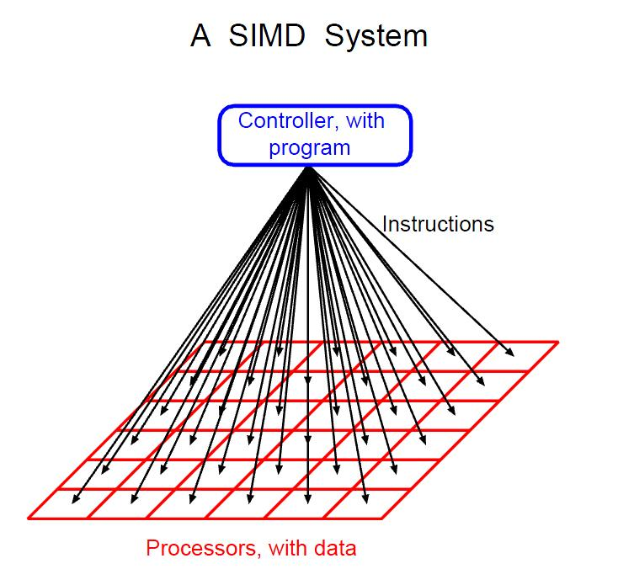
Parallel Thinking

Slide 13

Project #2: Parallel PageRank
(This project has two parts: part 1, sequential PageRank; part 2, parallel PageRank)
http://en.wikipedia.org/wiki/PageRank

Slide 14
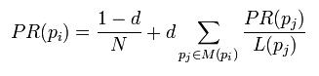
How PageRank is Calculated
PR, pagerank (a probability value)
p_{i} , a page under consideration
L(p_{i}), the number of outbound links on page p_{j}
d, damping factor which can be set between 0 and 1 (It is usually set to 0.85)
N, total number of pages
Note: Page ranks form a probability distribution over web pages, so the sum of all web pages' page ranks will be one.
Wikipedia

Slide 15
PageRank in the context of building a Distributed System
Algorithm (PageRank)
Architectures (MVC)
Communication (MPI, Hadoop)
Processes (Virtualization)
Communication (Messaging Middleware)
Synchronization (Clock, Order)
Performance Analysis (Scaling, Fault Tolerance)

Slide 16
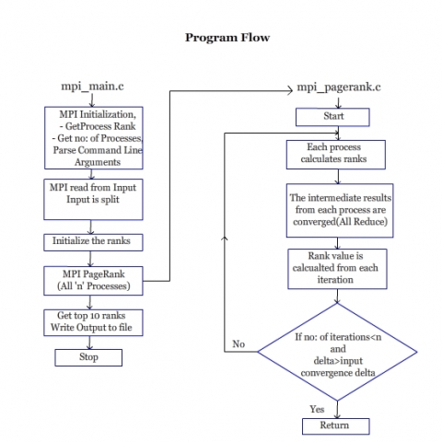

Slide 17
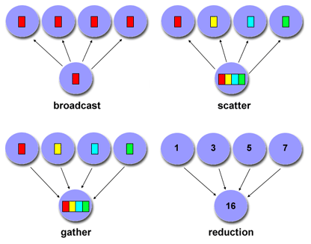
Scope of Communications
Point-to-Point vs. Collective

Slide 18
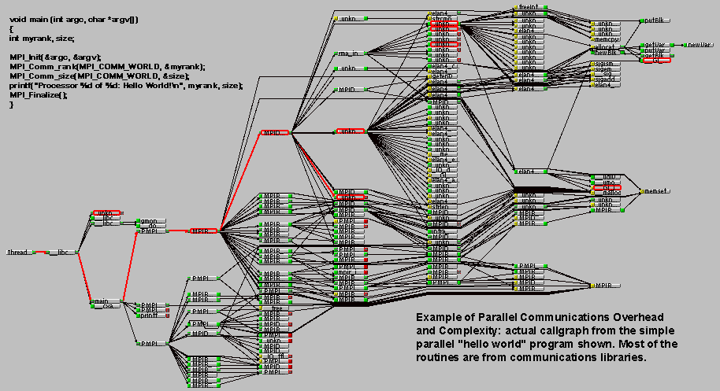
Overhead and Complexity

Slide 19
Message Passing Interface (MPI)
Portable Parallel Programs
William Gropp, ANL

Slide 20
MPI Basic Send/Receive
We need to fill in the details in:
Things that need specifying:
How will “data” be described?
How will processes be identified?
How will the receiver recognize/screen messages?
What will it mean for these operations to complete?
Process 0
Process 1
Send(data)
Receive(data)
William Gropp, ANL

Slide 21
What is message passing?
Data transfer plus synchronization
Process 0
Data
May I Send?
Data
Data
Data
Data
Data
Data
Data
Data
Process 1
Yes
Time
Requires cooperation of sender and receiver
Cooperation not always apparent in code
William Gropp, ANL

Slide 22
Sources of Deadlocks
Send a large message from process 0 to process 1
If there is insufficient storage at the destination, the send must wait for the user to provide the memory space (through a receive)
What happens with:
Process 0
Send(1)
Recv(1)
Process 1
Send(0)
Recv(0)
This is called “unsafe” because it depends on the availability of system buffers
William Gropp, ANL

Slide 23
Some Solutions to the “unsafe” Problem
Order the operations more carefully:
Process 0
Send(1)
Recv(1)
Process 1
Recv(0)
Send(0)
Use non-blocking operations:
Process 0
Isend(1)
Irecv(1)
Waitall
Process 1
Isend(0)
Irecv(0)
Waitall
William Gropp, ANL

Slide 24
MPI is Simple
Many parallel programs can be written using just these six functions, only two of which are non-trivial:
MPI_INIT
MPI_FINALIZE
MPI_COMM_SIZE
MPI_COMM_RANK
MPI_SEND
MPI_RECV
Point-to-point (send/recv)
Collective communication (broadcast)
William Gropp, ANL

Slide 25
MPI Messages
Message content, a sequence of bytes
Message needs wrapper
analogous to an envelope for a letter
Letter Message
Address Destination
Return Address Source
Type of Mailing (class) Message type
Letter Weight Size (count)
Country Communicator
Magazine Broadcast
William Gropp, ANL

Slide 26
A Minimal MPI Program (C)
#include "mpi.h"
#include <stdio.h>
int main( int argc, char *argv[] )
{
MPI_Init( &argc, &argv );
printf( "Hello, world!\n" );
MPI_Finalize();
return 0;
}
William Gropp, ANL

Slide 27
Better Hello (C)
#include "mpi.h"
#include <stdio.h>
int main( int argc, char *argv[] )
{
int rank, size;
MPI_Init( &argc, &argv );
MPI_Comm_rank( MPI_COMM_WORLD, &rank );
MPI_Comm_size( MPI_COMM_WORLD, &size );
printf( "I am %d of %d\n", rank, size );
MPI_Finalize();
return 0;
}
William Gropp, ANL

Slide 28
A Simple Exercise (Lab #5)
Compile and run the hello world program.
Time programs with MPI_WTIME. (Find it.)
William Gropp, ANL

Slide 29
MPI Basics
Communicator
Collection of processes
Determines scope to which messages are relative
Identity of process (rank) is relative to communicator
Scope of global communications (broadcast, etc.)

Slide 30
MPI Message Protocol, Send
message contents block of memory
count number of items in message
message type type of each item
destination rank of processor to receive
tag integer designator for message
communicator the communicator within which the message is sent

Slide 31
MPI Message Protocol, Receive
message contents buffer in memory to store
received message
count size of buffer
message type type of each item
source rank of processor sending
tag integer designator for message
communicator the communicator within which the message is sent
status information about message
received

Slide 32
Message Passing Example
#include <stdio.h>
#include <string.h>
#include "mpi.h" /* includes MPI library code specs */
#define MAXSIZE 100
int main(int argc, char* argv[])
{
int myRank; /* rank (identity) of process */
int numProc; /* number of processors */
int source; /* rank of sender */
int dest; /* rank of destination */
int tag = 0; /* tag to distinguish messages */
char mess[MAXSIZE]; /* message (other types possible) */
int count; /* number of items in message */
MPI_Status status; /* status of message received */

Slide 33
Message Passing Example
MPI_Init(&argc, &argv); /* start MPI */
/* get number of processes */
MPI_Comm_size(MPI_COMM_WORLD, &numProc);
/* get rank of this process */
MPI_Comm_rank(MPI_COMM_WORLD, &myRank);
/***********************************************/
/* code to send, receive and process messages */
/***********************************************/
MPI_Finalize(); /* shut down MPI */

Slide 34
Message Passing Example
if (myRank != 0){/* all processes send to root */
/* create message */
sprintf(message, "Hello from %d", myRank);
dest = 0; /* destination is root */
count = strlen(mess) + 1; /* include '\0' in message */
MPI_Send(mess, count, MPI_CHAR,
dest, tag, MPI_COMM_WORLD);
}
else{/* root (0) process receives and prints messages */
/* from each processor in rank order */
for(source = 1; source < numProc; source++){
MPI_Recv(mess, MAXSIZE, MPI_CHAR,
source, tag, MPICOMM_WORLD, &status);
printf("%s\n", mess);
}
}

Slide 35
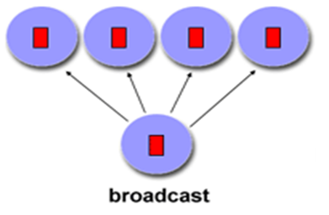
Broadcasting a message
Broadcast: one sender, many receivers
Includes all processes in communicator; all processes must make an equivalent call to MPI_Bcast
Any processor may be sender (root), as determined by the fourth parameter
First three parameters specify message as for MPI_Send and MPI_Recv, fifth parameter specifies communicator
Broadcast serves as a global synchronization

Slide 36
MPI_Bcast() Syntax
MPI_Bcast(mess, count, MPI_INT, root, MPI_COMM_WORLD);
mess pointer to message buffer
count number of items sent
MPI_INT type of item sent
Note: count and type should be the same on all processors
root sending processor
MPI_COMM_WORLD communicator within which broadcast takes place

Slide 37
Timing Programs
MPI_Wtime()
returns a double giving time in seconds from a fixed time in the past
To time a program, record MPI_Wtime() in a variable at start, then again at finish; difference is elapsed time
startime = MPI_Wtime();
/* part of program to be timesd */
stoptime = MPI_Wtime();
time = stoptime - starttime;

Slide 38
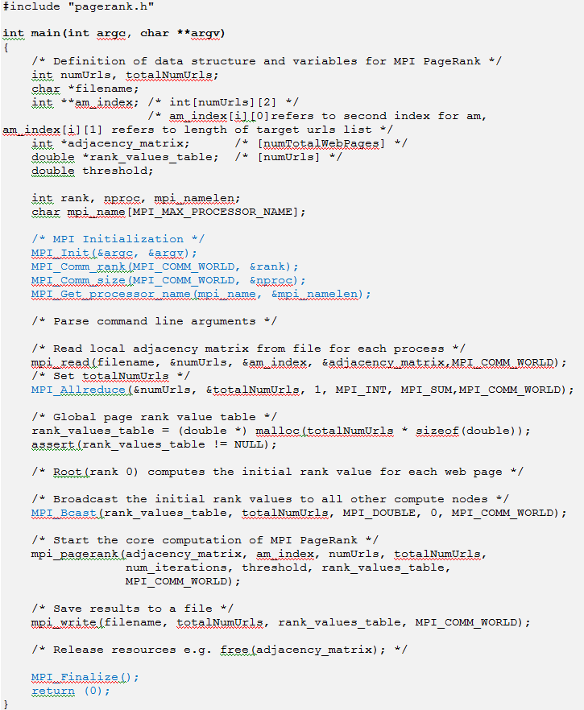
Start
Timer
Stop
Timer

Slide 39
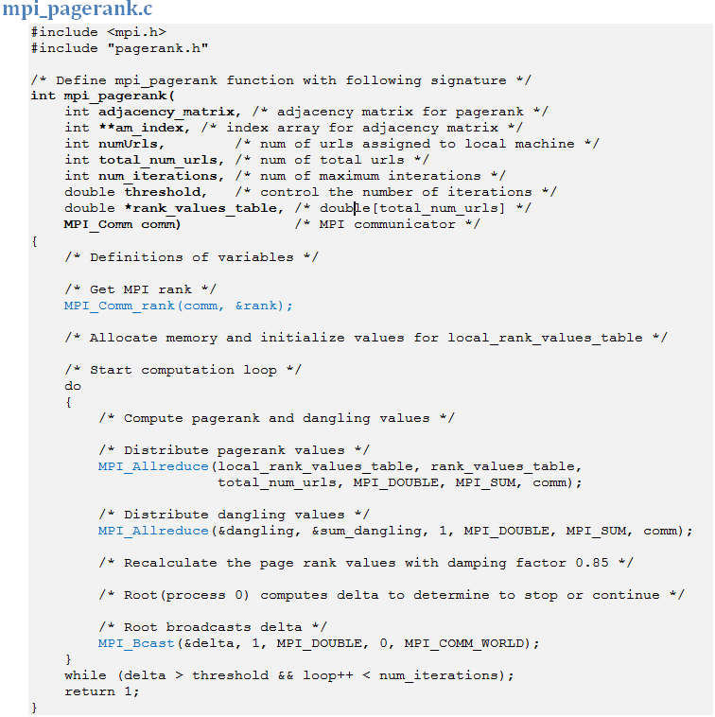

Slide 40
PageRank Calculation (one iteration)
Local
O(n)
while(ite.hasNext()){
source_url = ((Integer)ite.next()).intValue();
target_urls_list = adjacency_matrix.get(source_url);
int outdegree_of_source_url = target_urls_list.size();
for (int i=0; i<outdegree_of_source_url;i++){
target_url = target_urls_list.get(i).intValue();
intermediate_rank_value = intermediate_rvt.get(target_url)+
rank_values_table.get(source_url)/double)outdegree_of_source_url;
intermediate_rvt.put(target_url, intermediate_rank_value);
}
if (outdegree_of_source_url == 0)
dangling_value += rank_values_table.get(source_url);
}//while
for (int i=0;i<num_urls;i++) // dangling value
rank_values_table.put(i,intermediate_rvt.get(i)+ dangling_value / (double)num_urls);
for (int i=0;i<num_urls;i++) // damping factor
rank_values_table.put(i, damping_factor*rank_values_table.get(i)+(1-damping_factor)*1.0/(double)num_urls);
Time complexity O(n<k>)
n
O(<k>), where <k> = (1/n)∑ k_{i}
i= 1
MPI_AllReduce()
Time complexity O(N)

Slide 41

Computation of PageRank
HashMap<Integer,ArrayList<Integer>> adjacency_matrix
0
1 2
2 1
3 0 1
4 1 3 5
5 1 4
6 1 4
7 1 4
8 1 4
9 4
10 4
?
Partition & Load Balance

Slide 42
MPI PageRank Data Flow
Input Data
Data Partition
Compute
AllReduce
Output Data
Adjacency matrix
0 1 2 2 1
P
a
g
e
r
a
n
k
0
1 2
2 1
*Adjacency Matrix
Process 0
3 0 1
4 1 3 5
5 1 4
Adjacency_matrix
3 0 1 4 1 3 5 5 1 4
0
1 2
2 1
3 0 1
4 1 3 5
5 1 4
6 1 4
7 1 4
8 1 4
9 4
10 4
Process 1
6 1 4
7 1 4
8 1 4
Adjacency_matrix
6 1 4 7 1 4 8 1 4
Output
Data
Process 2
Adjacency_matrix
9 4 10 4
9 4
10 4
Process 3

Slide 43
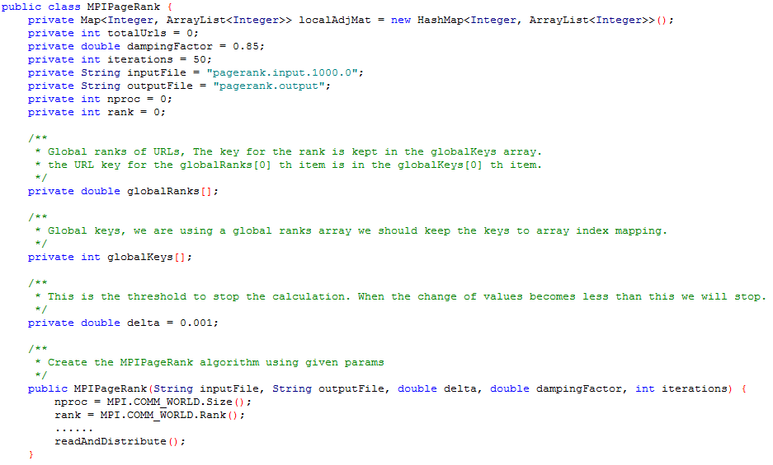

Slide 44
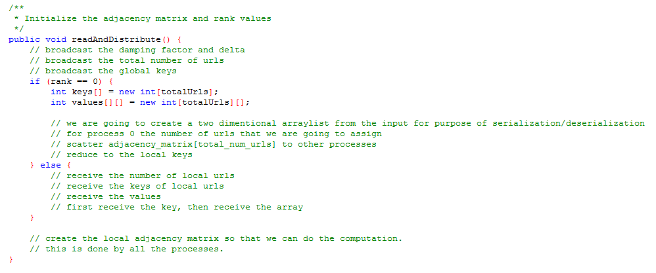

Slide 45
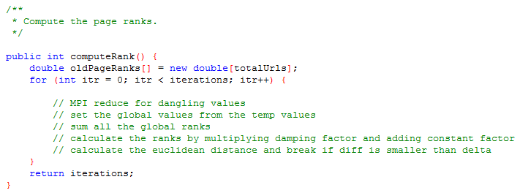

Slide 46
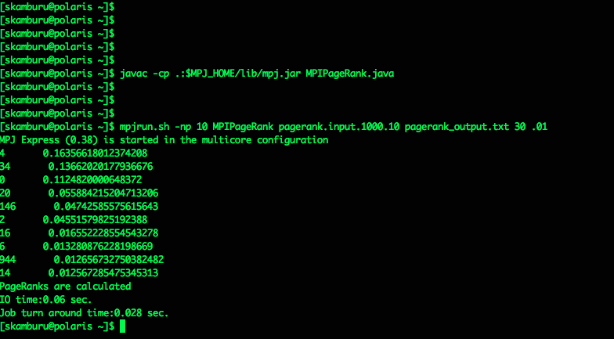
Running MPI Pagerank
(burrow.cs.indiana.edu or silo.cs.indiana.edu)
Step 1: Compile the program
Step 2: Run MPI pagerank
Step 3: Check results

Slide 47
MPI PageRank
Program Control Flow
Data Partition
Local variables
Global variables
Communication
Point-to-Point
Collectives
Runtime Behavior of Process 0 and Process i
if
else
Performance Measurement
Speedup

Slide 48
Parallelization of PageRank
Broadcast
Partition
Partition
Partition
PR,L
…
…
…
PR,L
…
…
…
Ck
PR,L
…
…
…
…
AllReduce
PR1 | PR2 | PR3 | … | … | … | PRn

Slide 49
More about PageRank
Page specific factors
Anchor text of inbound or outbound links
Top 10 Page Ranks
Performance analysis

Slide 50
Project Report Template
Topic (e.g. project title, author list, emails and affiliations)
Statement of problem (and objectives)
Theory (e.g. mathematical models)
Architecture design (e.g. architecture flowchart and text)
Implementations (e.g. data structure and methods, programming languages and runtime environments)
Discussions (e.g. results, findings and performance analysis)
Conclusions (and future work)
Acknowledgements
References

